Slide 1



EasyHealth
Healthcare Information Management system
A guide by
Mario Molinara
Develop by
Taiabur Imran Zain

Slide 2
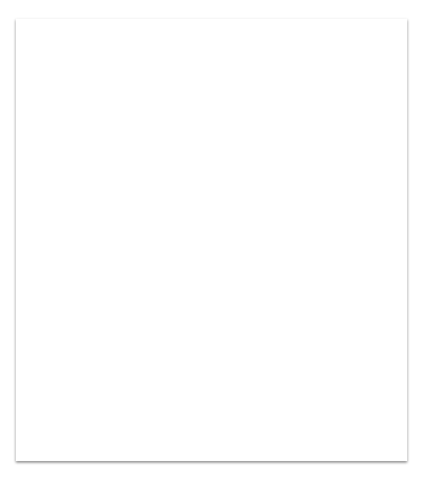
Outline
Objective Highlight about project details.
Project Overview
Mockup of the Application
Must have
Should Have
Could have
Environment and technologies
Milestone

Slide 3
Objective
To develop a comprehensive Healthcare Information Management System that streamlines the process of managing healthcare data and facilitates efficient healthcare service delivery.

Slide 4
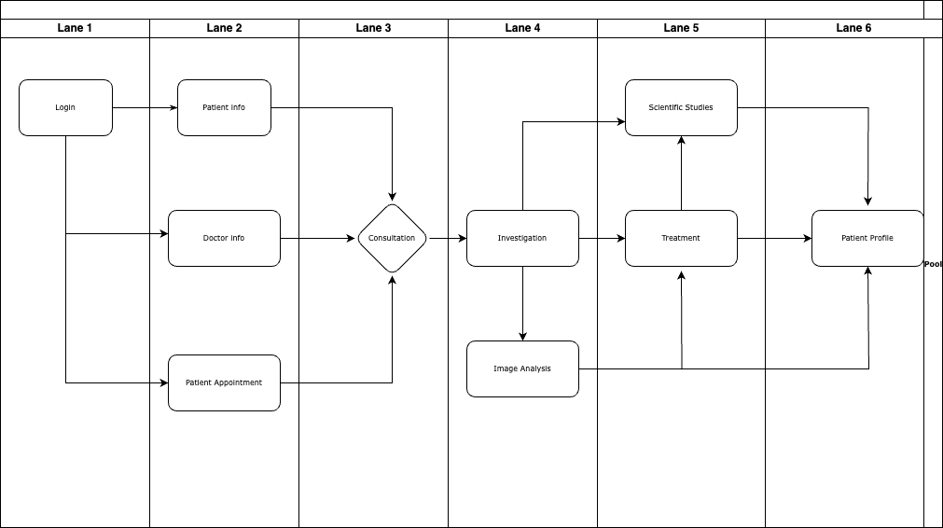

Slide 5
Mockup
Must-Have Features
User authentication and access control for healthcare professionals.
Patient registration and management.
Doctor registration and management.
Electronic Health Records (EHR) management.
Appointment scheduling and management.
Prescription and medication management.
Reporting and analytics for data-driven decision making.

Slide 6
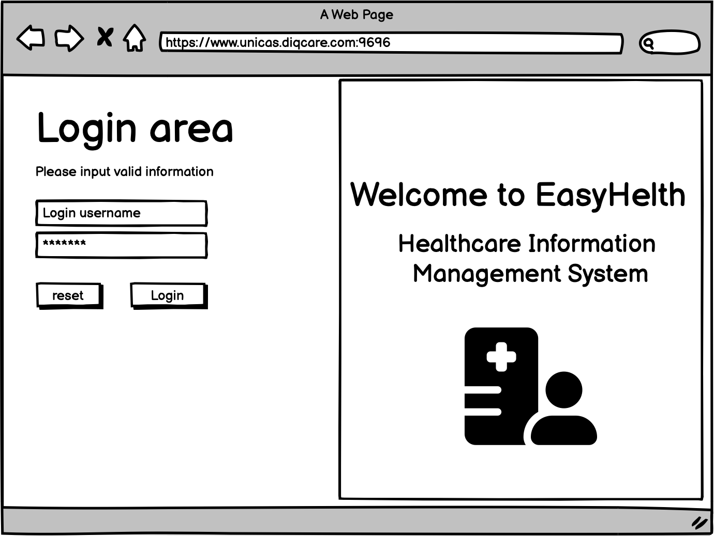
Mockup
Must have

Slide 7
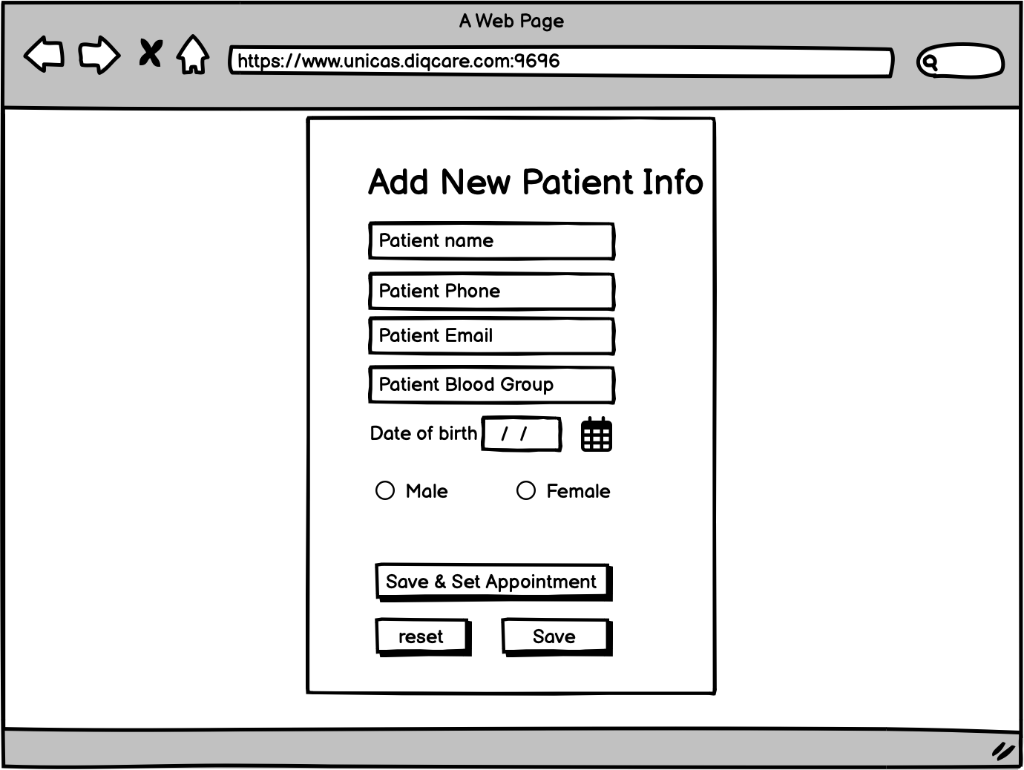
Mockup
Must have

Slide 8
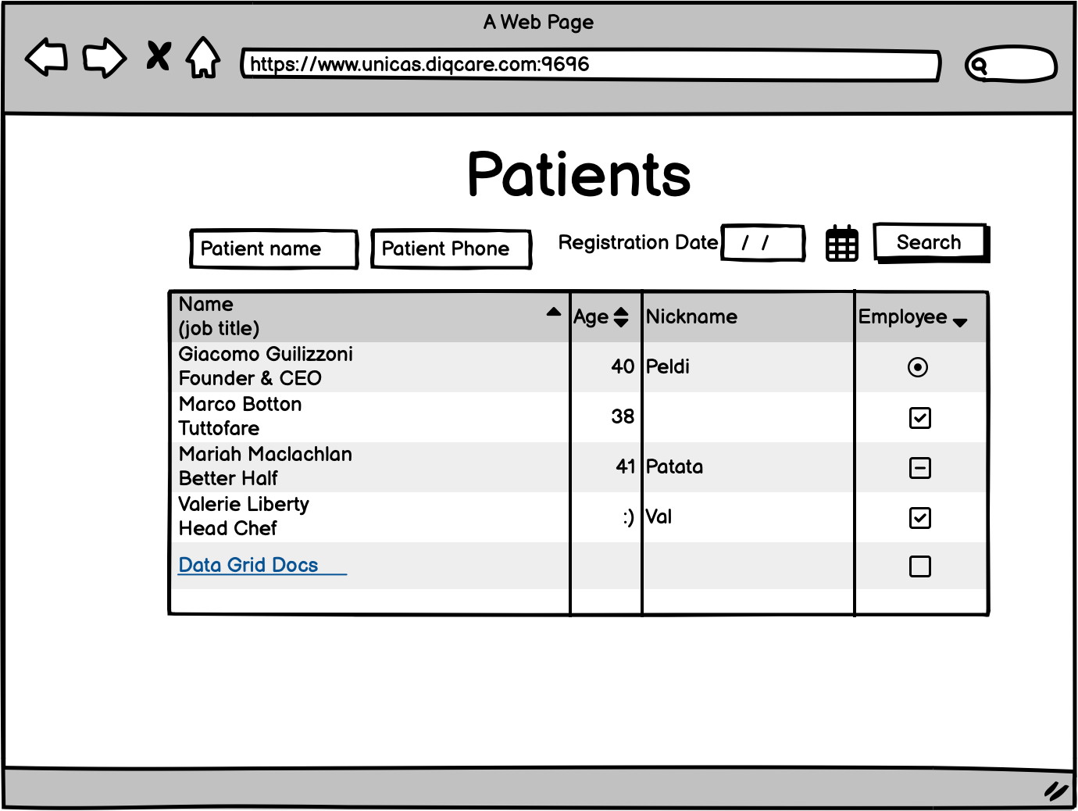
Mockup
Must have

Slide 9
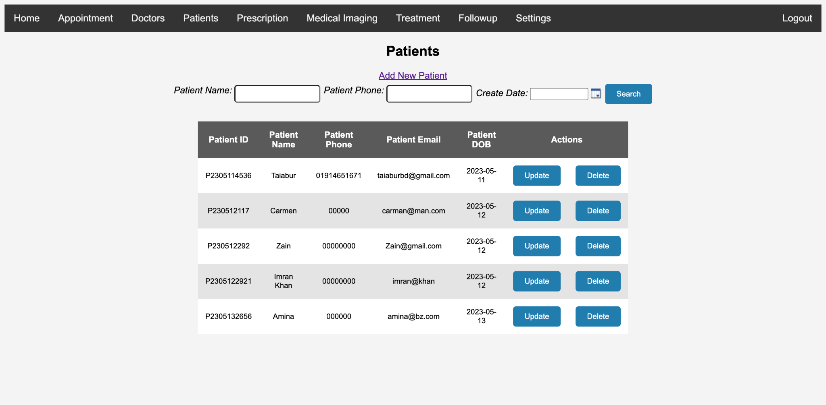
Mockup
Must have

Slide 10
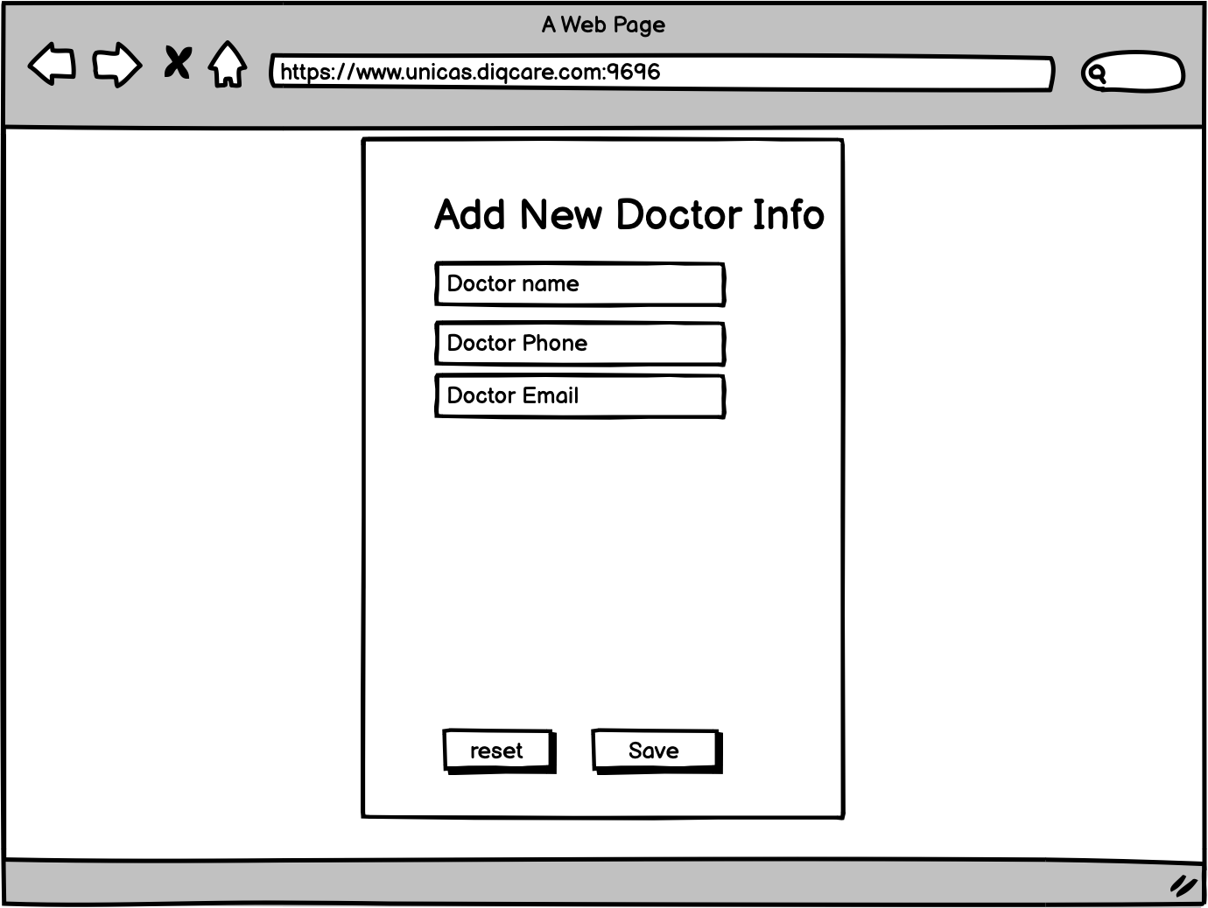
Mockup
Must have

Slide 11
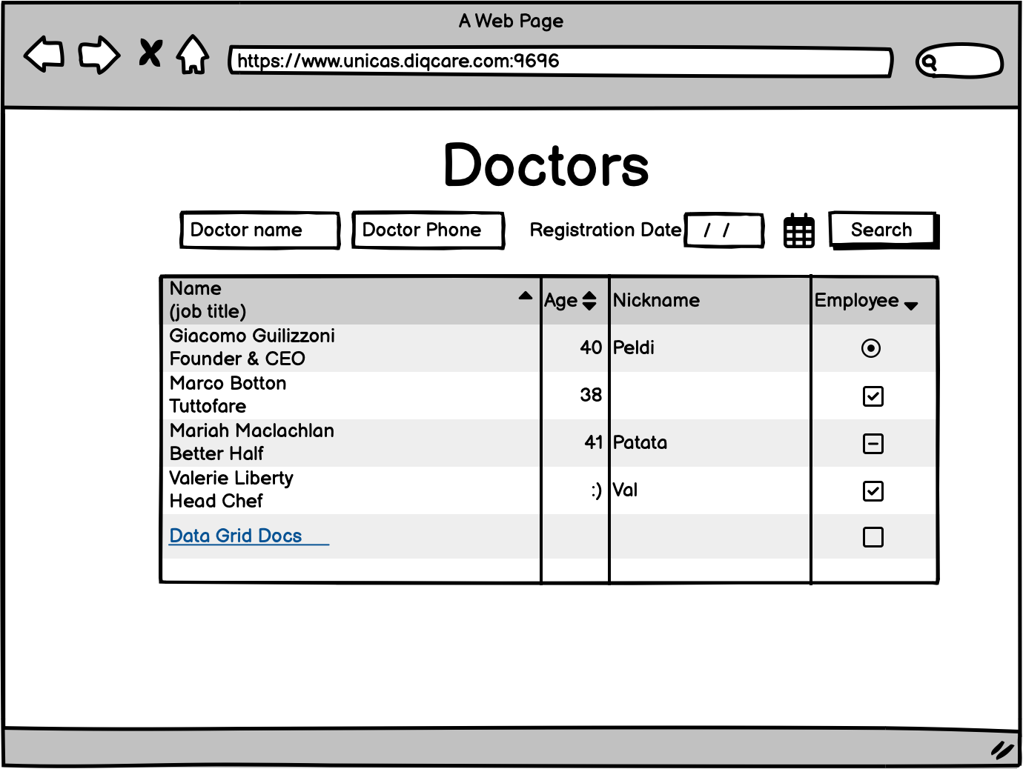
Mockup
Must have

Slide 12
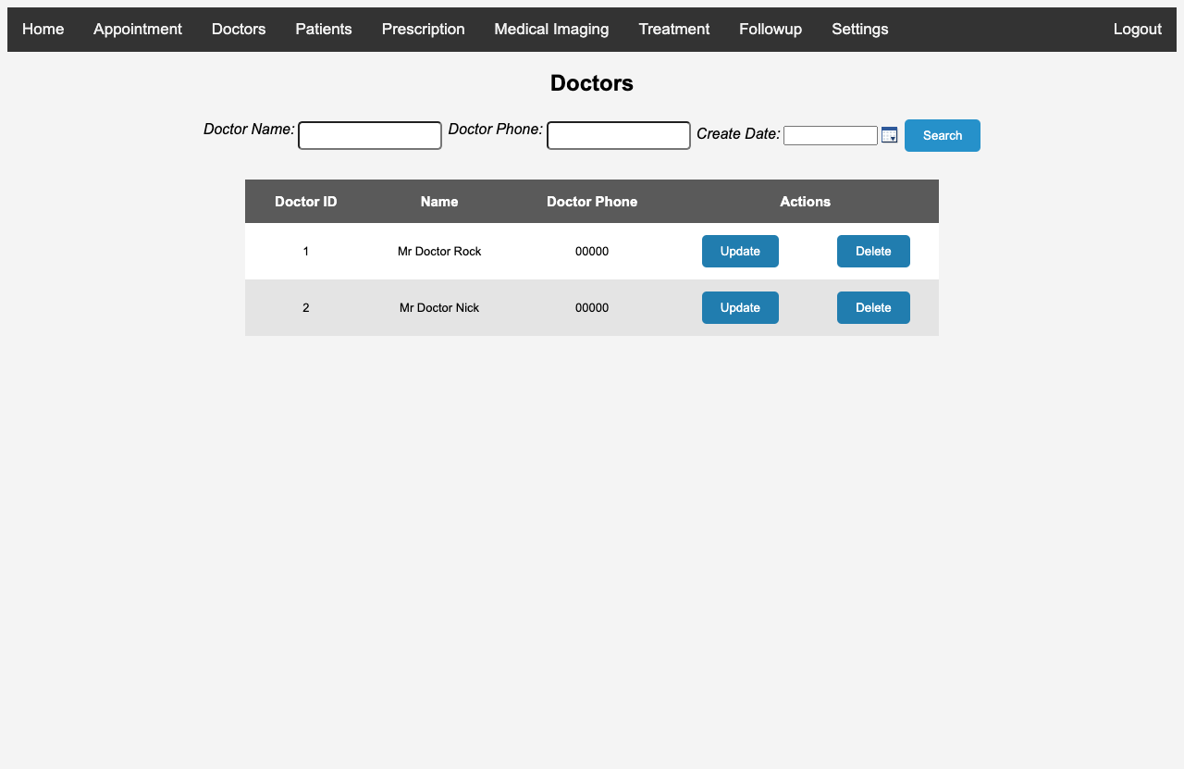
Mockup
Must have

Slide 13
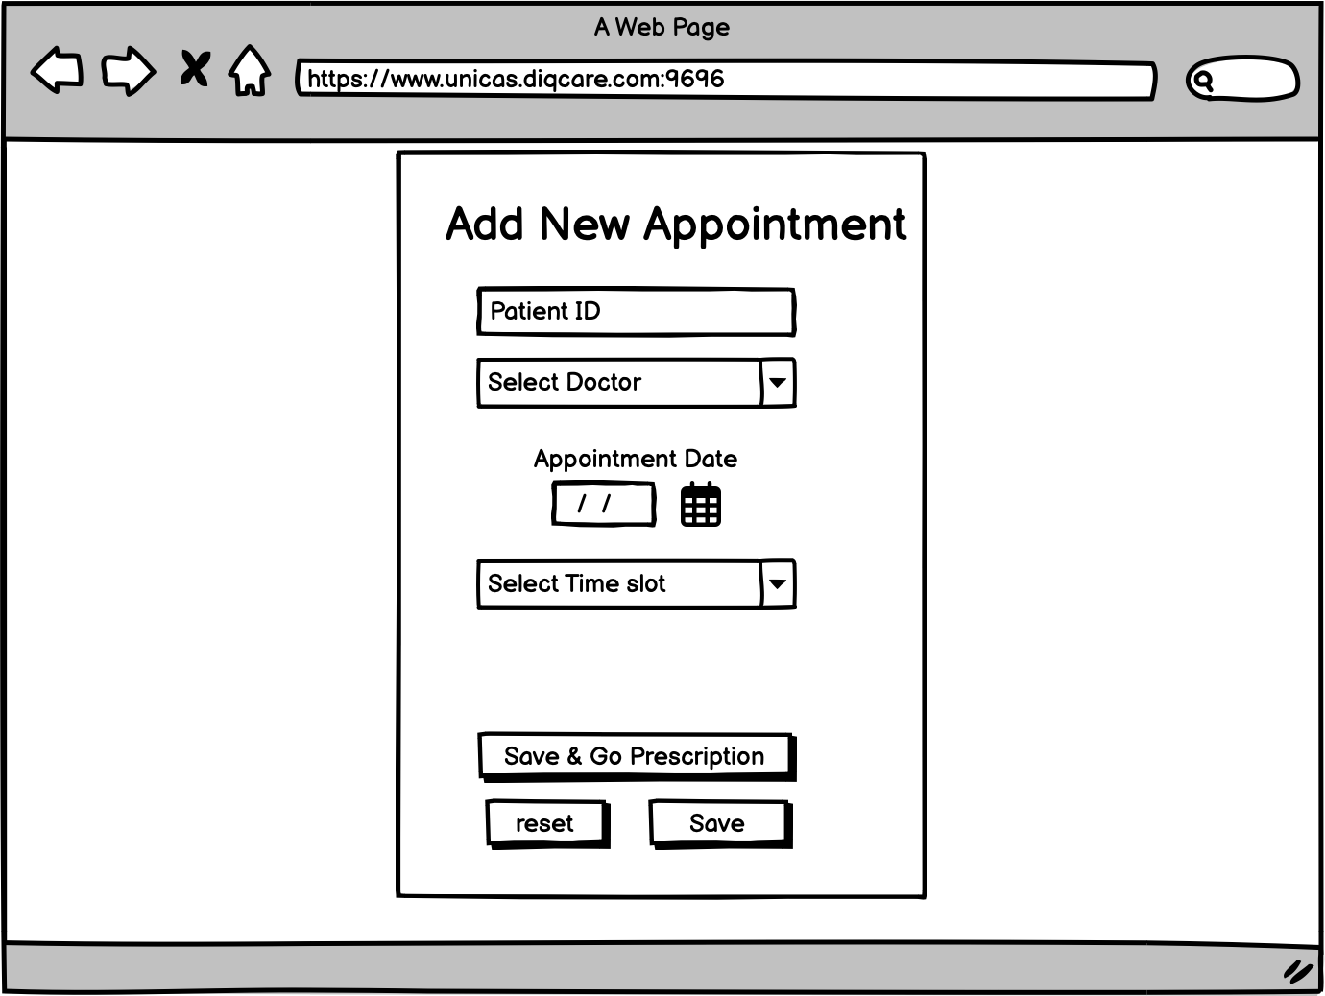
Mockup
Must have

Slide 14
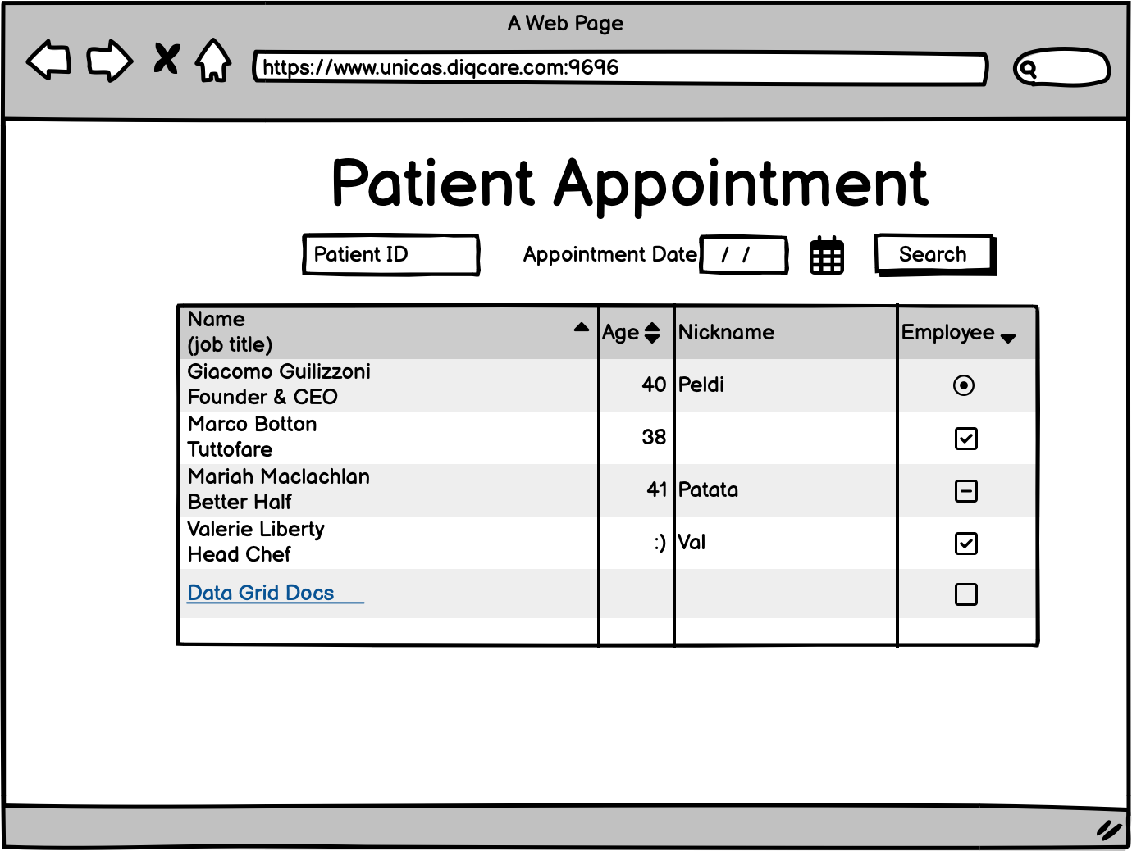
Mockup
Must have

Slide 15
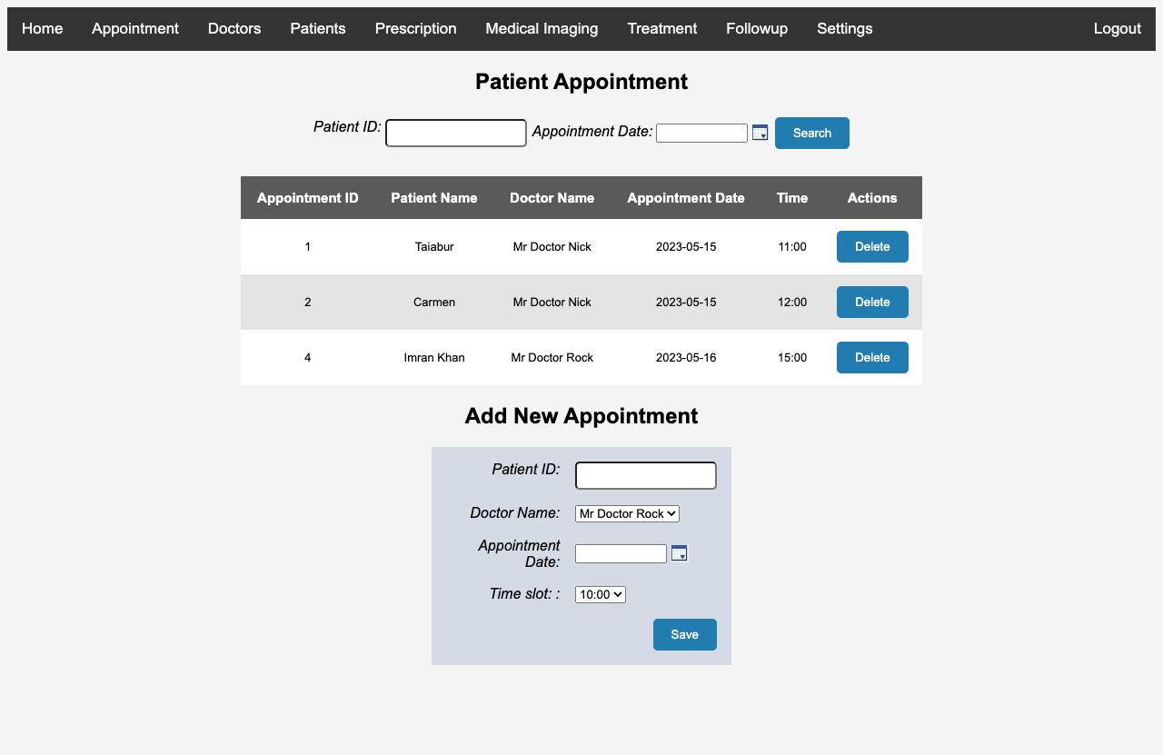
Mockup
Must have

Slide 16
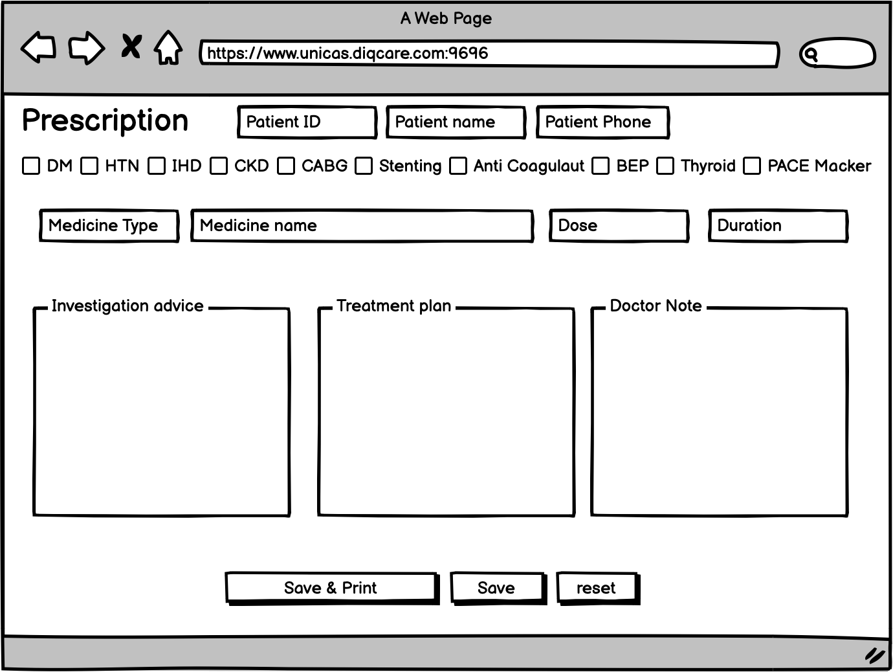
Mockup
Must have

Slide 17
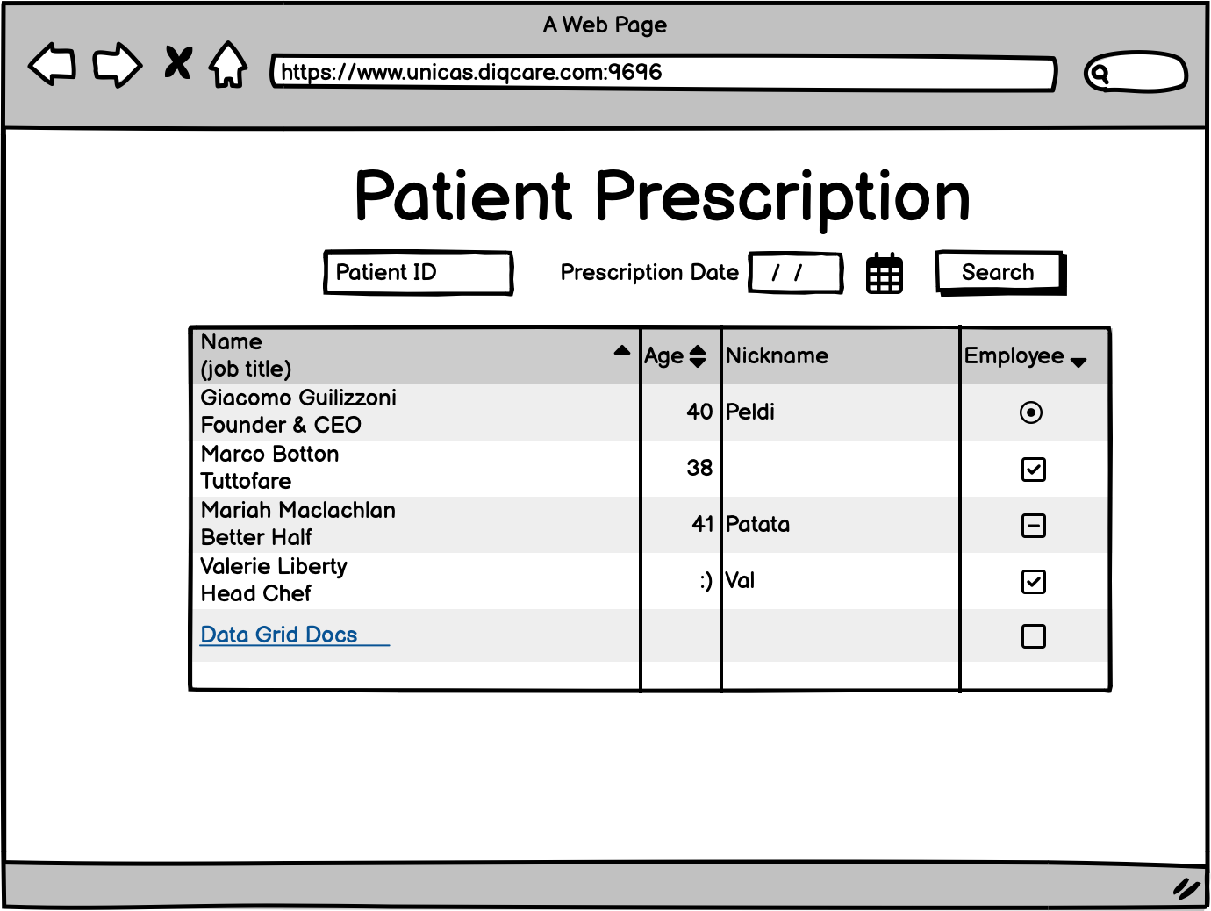
Mockup
Should have

Slide 18
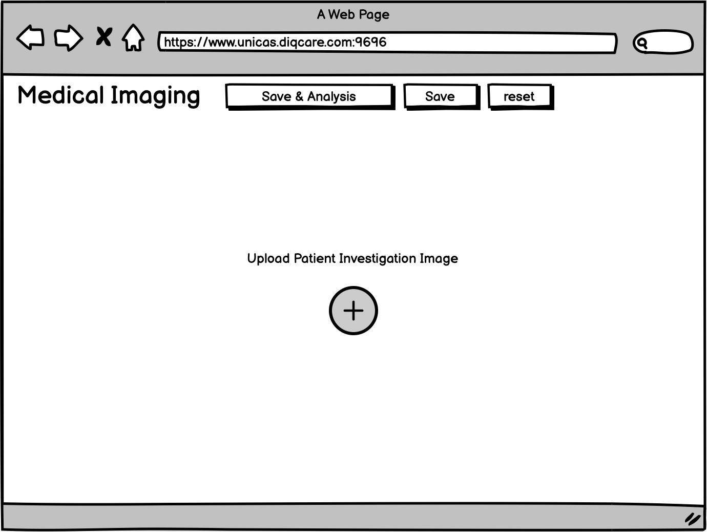
Mockup
Could have

Slide 19
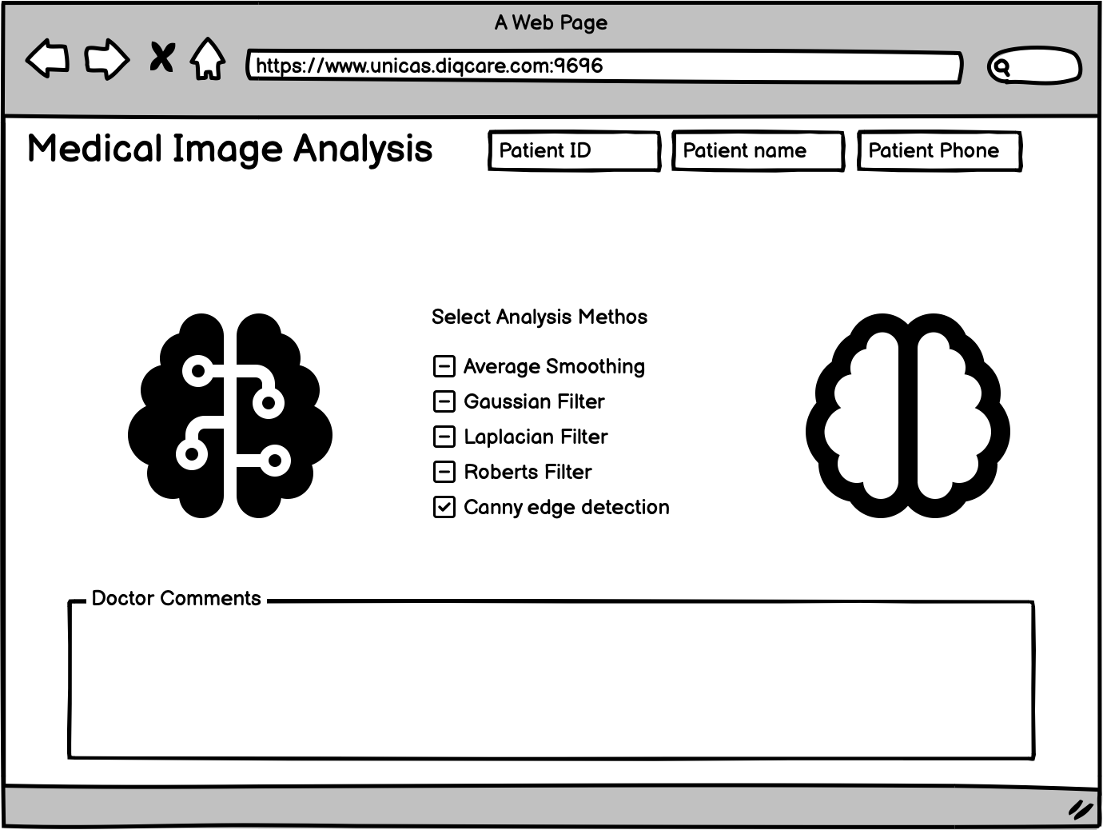
Mockup
Could have

Slide 20
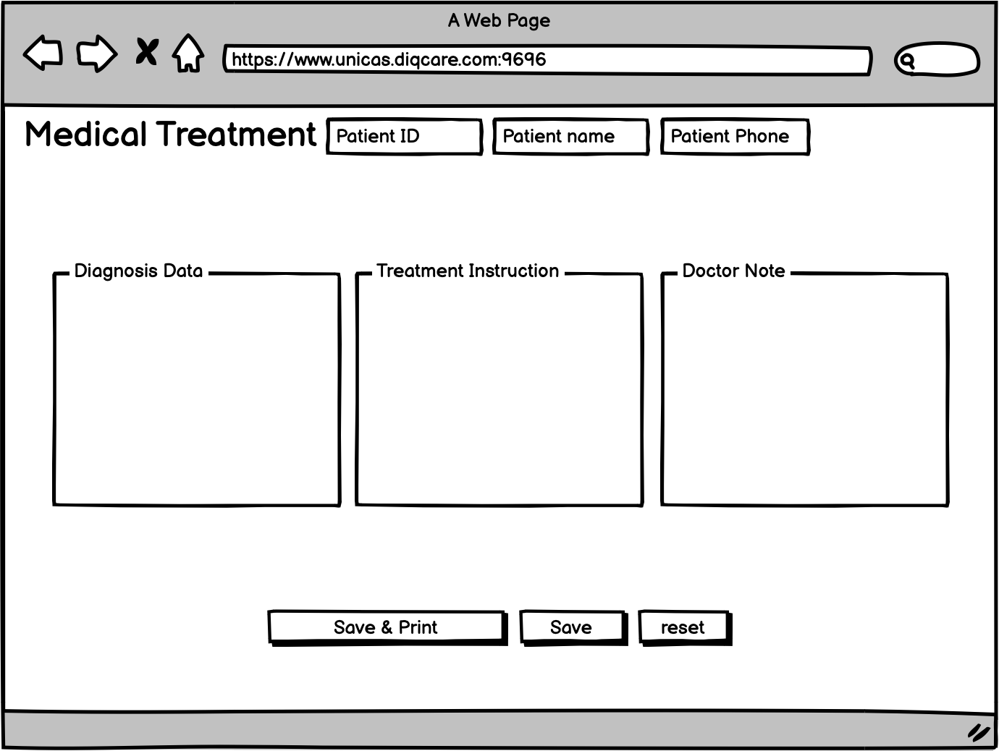
Mockup
Could have

Slide 21
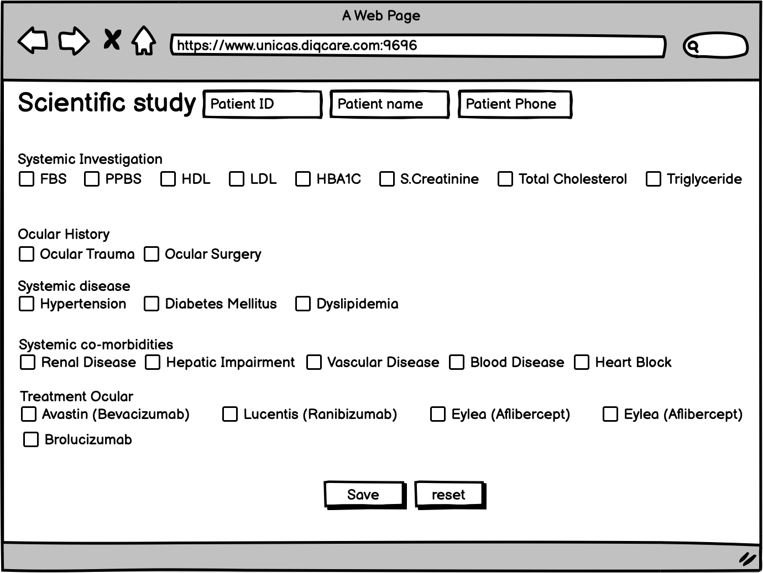
Mockup
Could have

Slide 22



]
Operating System Ububtu 20.04
Webserver Tomcat 9.0.74.

Slide 23
Tools
Frontend tools
HTML
CSS
JavaScript
Jquery
Backend
OOP Java
Databases
MySql

Slide 24
Milestones
May 2023 (Last week)
June 2023 (first week)
Final Version Release
Design and Development
Release beta version
Week 1 |  |  |  | Week 2
Bug fixing and final version release

Slide 25

Thank you!

